Slide 1

AUTOBIOGRAPHY: THE DREAM GIRL CHILD

Slide 2

INTRODUCTION
The world was a canvas, and I was the artist, eager to explore every corner of it
My parents, the architects of my dreams, nurtured my curiosity and stoked the flames of ambition that burned within me
They believed in the power of education and instilled in me the unwavering belief that knowledge was the key to unlocking my full potential
The pursuit of knowledge became a passionate affair, and I found solace in the world of books, each page a stepping stone on my journey toward fulfilling my dreams
The journey from dream girl child to the person I am today has been marked by growth, self-discovery, and the pursuit of excellence
My dreams have evolved, as have I, and I am continually inspired by the endless possibilities that life presents

Slide 3
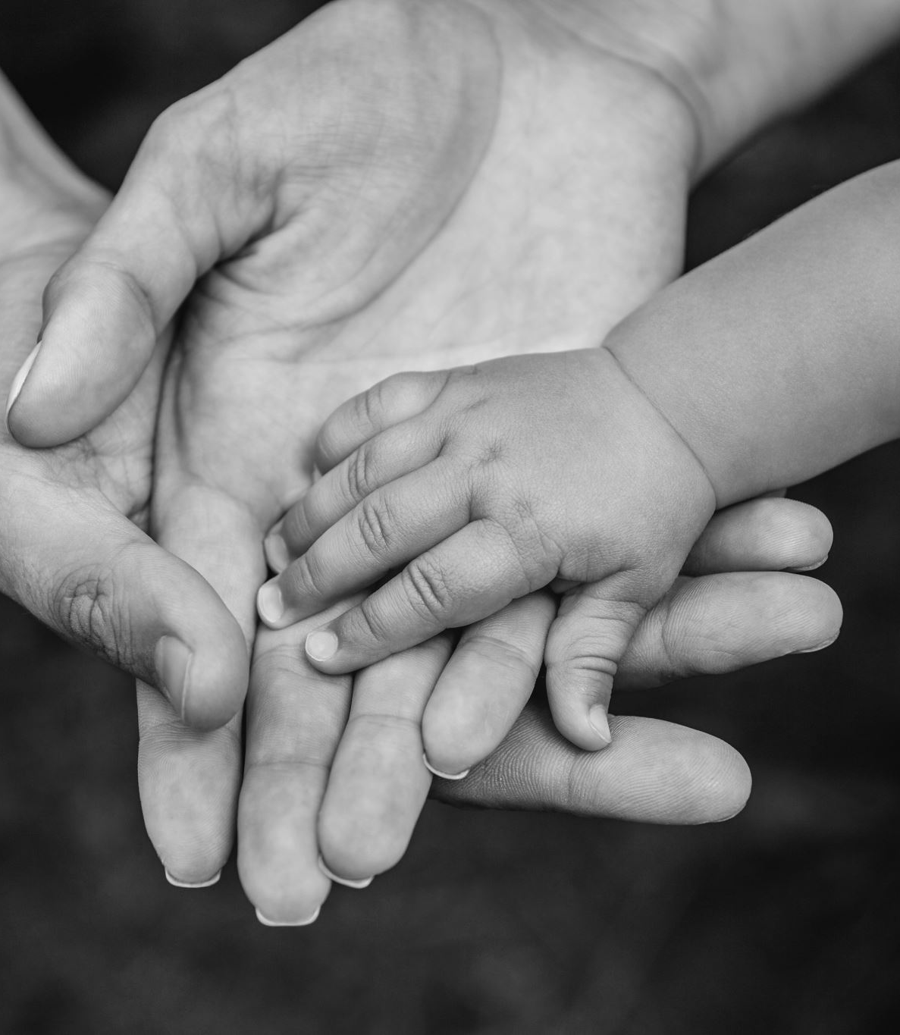
**My Early Life and Family: Introduction**
My name is Sheila, and I invite you to join me on a journey through my early life and family
This is a story woven with love, dreams, and the cherished presence of my younger sister, Olympia Mbogoh, as we embark on the path of life's adventures

Slide 4
*Chapter 1: A Blessed Beginning**
I was born into a world brimming with endless possibilities, on a serene morning in the heart of our bustling city
My parents, Maria and David, welcomed me with open arms, their hearts filled with hopes and dreams
As their firstborn, I was a bundle of joy and the embodiment of their aspirations for the future

Slide 5
**Chapter 2: The Foundation of Love**
Our family was the cornerstone of my early years
The deep love my parents held for each other and for us, their children, set the stage for a childhood filled with warmth and security
In our home, family was the most important bond we could have, and their love became the foundation upon which we built our lives

Slide 6

*Chapter 3: The Curious Explorer**
From a young age, I was an inquisitive child, my curiosity evident in everything I did
I embarked on a journey of exploration with wide-eyed wonder, eager to learn and discover
My parents recognized this spark of curiosity within me and wholeheartedly encouraged me to ask questions, explore my interests, and embrace the wonders of the world

Slide 7
**Chapter 4: The Arrival of Olympia**
My younger sister, Olympia Mbogoh, entered our lives when I was just three years old
His birth was a moment of great excitement in our family
Our sibling bond began to flourish as we navigated the joys and challenges of early life together

Slide 8
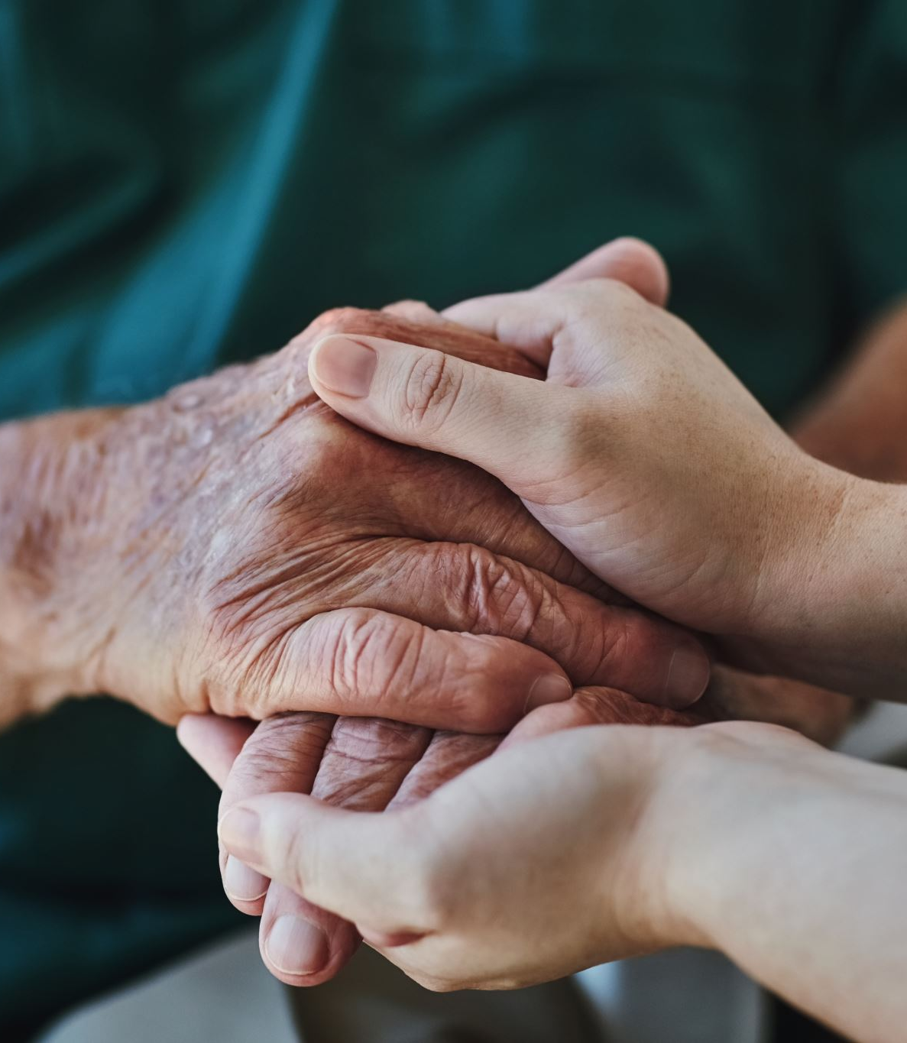
**Chapter 5: Roots and Heritage**
Our family was enriched by traditions and values, many of which were passed down from our grandparents, Anne and John
Their home was a sanctuary of love, where stories of our ancestors were shared with reverence
My grandmother, Anne, was a gifted storyteller, and her tales instilled in us a deep appreciation for our cultural heritage and the importance of knowing our roots

Slide 9
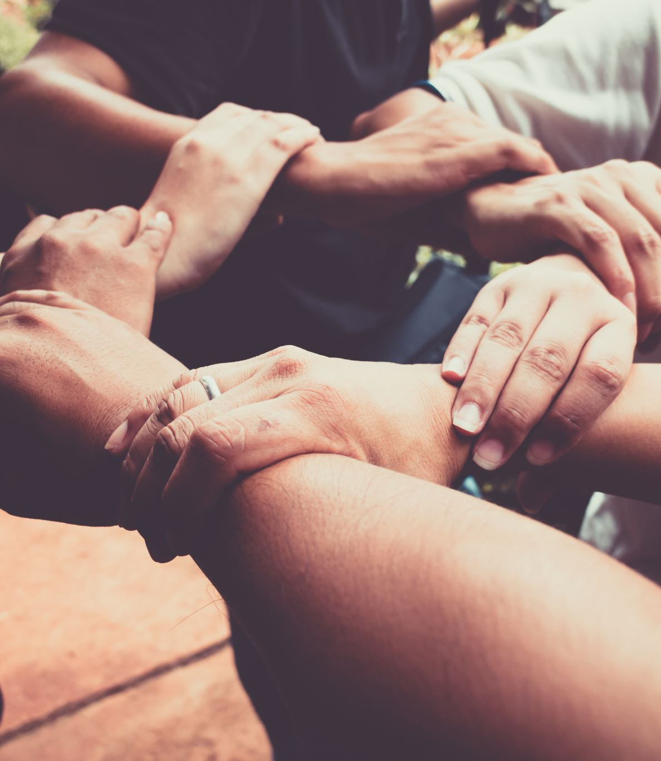
**Chapter 6: Bonds Beyond Family**
Our neighborhood was a close-knit community, where neighbors were like extended family
Lasting friendships were forged, creating pillars of support and camaraderie that would stand the test of time
These friendships and the memories we created would shape us into the individuals we are today

Slide 10

**Chapter 7: The Value of Education**
Education held a paramount place in our family
My parents believed in the power of knowledge and encouraged my sister and me to explore our interests
The local library was my sanctuary, where my imagination soared, and I could dream and learn without bounds

Slide 11
**Chapter 8: Resilience in Adversity**
Our family faced its share of challenges, as every family does
Through these trials, we learned the value of resilience and determination
My parents' unwavering support and their ability to face difficulties with grace left an indelible mark on me

Slide 12

**Chapter 9: A Canvas of Expression**
As I grew, I discovered my passion for the arts, particularly painting
My room became a gallery of my creations, each canvas a reflection of my thoughts and emotions
Through art, I learned the power of self-expression and the beauty of translating feelings into tangible forms

Slide 13

**Chapter 10: Celebrating Heritage**
The traditions instilled by our grandparents remained a guiding light in our lives
Family gatherings were cherished rituals where stories were shared, laughter echoed, and the rich tapestry of our heritage was celebrated
These moments served as a reminder of the significance of family bonds and cultural connections

Slide 14

**Chapter 11: The Sibling Bond**
My relationship with Olympia was marked by love and a sense of responsibility
As the older sister, I embraced my role with warmth and wisdom
Olympia was not just my sister; he was my confidant and my partner in the journey of life

Slide 15

**Chapter 12: Lessons of Giving Back**
Early life serves as the building blocks of character, and for me, it was a journey of self-discovery
My parents, Maria and David, were instrumental in shaping my values
They instilled in me the importance of empathy, kindness, and giving back to the community

Slide 16

**Chapter 13: Navigating Adolescence**
As I entered my teenage years, the prospect of adulthood loomed on the horizon
I felt a growing sense of identity and purpose
My love for literature, art, and community service coalesced, and I began to envision a future where I could make a meaningful impact in the world

Slide 17
**Chapter 14: The Guiding Light**
Education remained at the forefront of my journey
As I embarked on the path of higher learning, my family stood by me, offering unwavering support and encouragement
The values instilled in me during my early years became my guiding principles, helping me navigate the challenges and celebrate

Slide 18
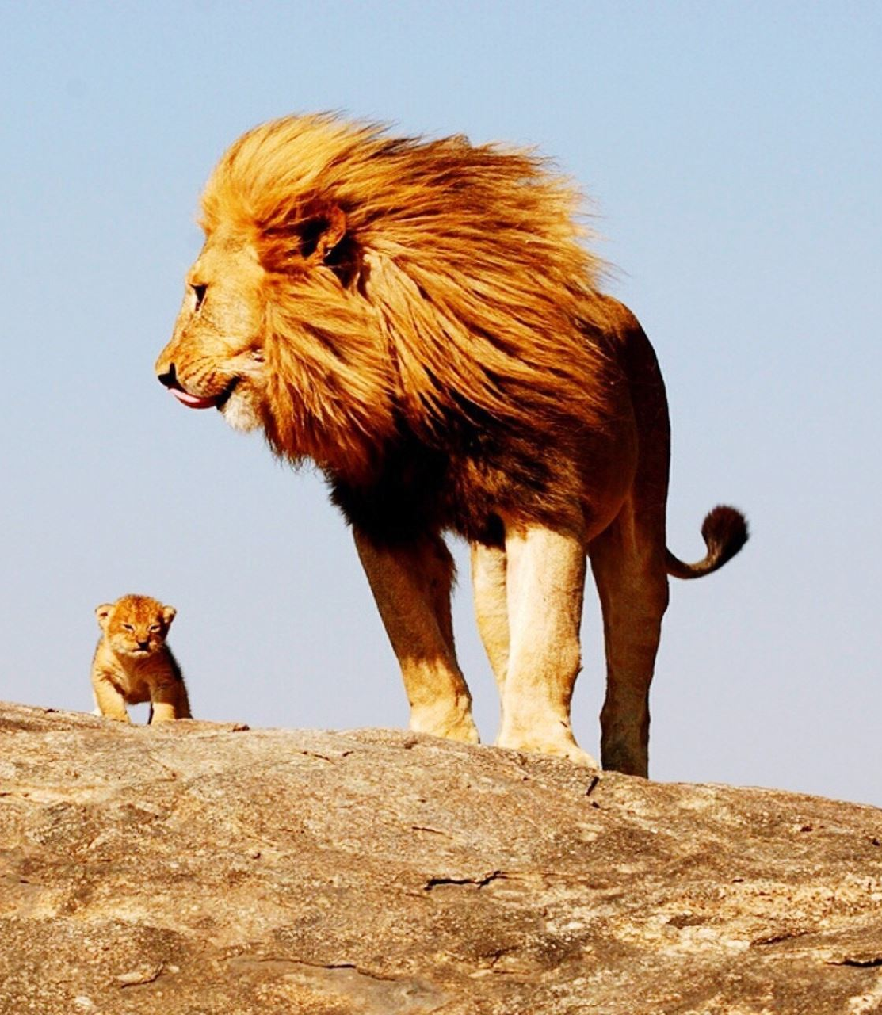
**Childhood and Education Background: Introduction**
Allow me to take you through the significant chapters of my educational journey, from my early days in primary school to my current pursuit of knowledge at Dedan Kimathi University
My educational voyage commenced at Lion's School, the place where I first stepped onto the path of knowledge and self-discovery
Lion's School was more than just a place of learning; it was where I unearthed my love for sports, particularly football, and my role as a goalkeeper

Slide 19

**Chapter 2: The Goalkeeper's Journey**
As the school's goalkeeper, I found myself learning about teamwork, dedication, and the thrill of competition
Tireless practice honed my skills, and I developed the reflexes needed to guard the goal
The responsibility of defending the goalposts became a defining aspect of my early life, shaping my character and instilling a sense of duty

Slide 20

**Chapter 3: Balancing Academics and Passion**
Lion's School offered a strong academic foundation, but it was also the place where I discovered the importance of discipline, time management, and the pursuit of excellence
This balance between my academic commitments and passion for sports would be a guiding principle for the years ahead

Slide 21
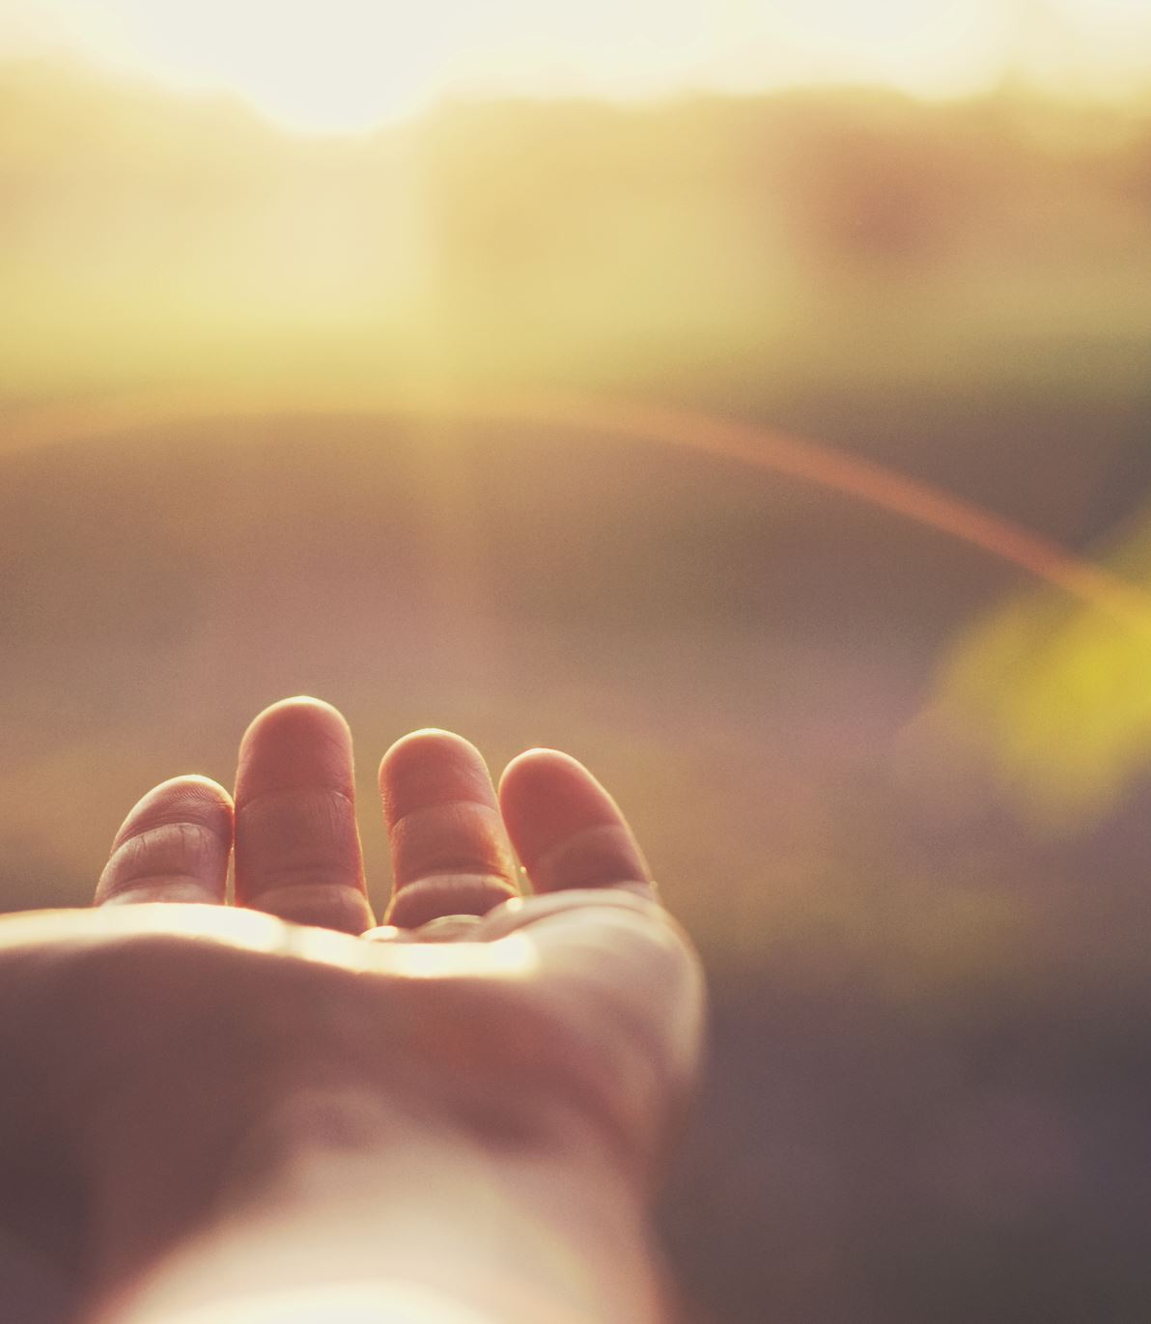
**Chapter 4: Early Mornings and Guiding Lights**
Each day at Lion's School began with the soft chime of the alarm clock and the warmth of the early morning sun
Guided by my mother, who served not only as my caregiver but also as my mentor, I prepared for school with punctuality and care
Meticulous attention was given to my uniform, ensuring that it was immaculate, symbolizing my commitment to education

Slide 22
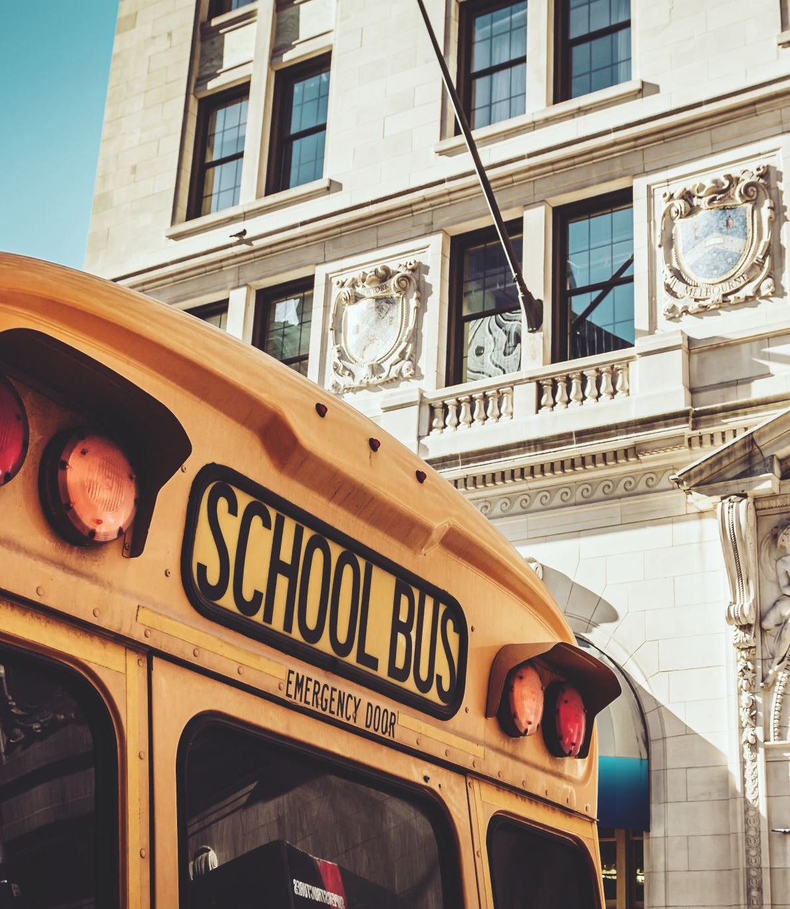
**Chapter 5: The Journey to School**
The school bus, a bright yellow symbol of learning, would arrive at my doorstep, ready to transport eager young minds to the realm of knowledge
The journey to school was a time of preparation, reflection, and anticipation, setting the tone for the day ahead

Slide 23
**Chapter 6: Lessons of Leadership**
As a class prefect at Lion's School, I embraced a role of leadership and responsibility
My involvement in the Girls Guide was a pivotal part of my early education
The parade, a significant event within the Girls Guide, reinforced the importance of unity, teamwork, and discipline

Slide 24

**Chapter 8: Raising the Flag**
A moment of immense pride was raising the school flag in front of the entire school
It symbolized a commitment to upholding the values of our institution and taught me about respect, patriotism, and the significance of symbols in our society

Slide 25

**Chapter 9: The Pursuit of Academic Excellence**
As a young student, my determination and love for learning reflected in my academic achievements, striving for the highest marks in my class
Lion's Schools Primary School served as the foundation upon which my character and aspirations were built
The friendships, lessons, and experiences from my early years at Lion's School would accompany me on my educational journey, inspiring me to continue seeking knowledge and chasing my dreams

Slide 26

**Muthale Girls Secondary School: Early Beginnings**

Slide 27
**Chapter 1: A New Chapter Begins**
My educational journey took a significant turn when I crossed the threshold of Muthale Girls Secondary School in Kitui County
These formative years of adolescence were marked by experiences that would shape my character, instill discipline, and ignite a passion for excellence
Muthale Girls was not merely an institution of learning; it was a place where lifelong friendships were forged, values were deeply instilled, and dreams were nurtured
It served as a haven for personal growth and self-discovery, offering not only academic excellence but also a platform for athletic pursuits
My days at Muthale Girls commenced in the quiet predawn hours, well before the sun painted the horizon
My responsibilities at Muthale Girls extended beyond academics

Slide 28
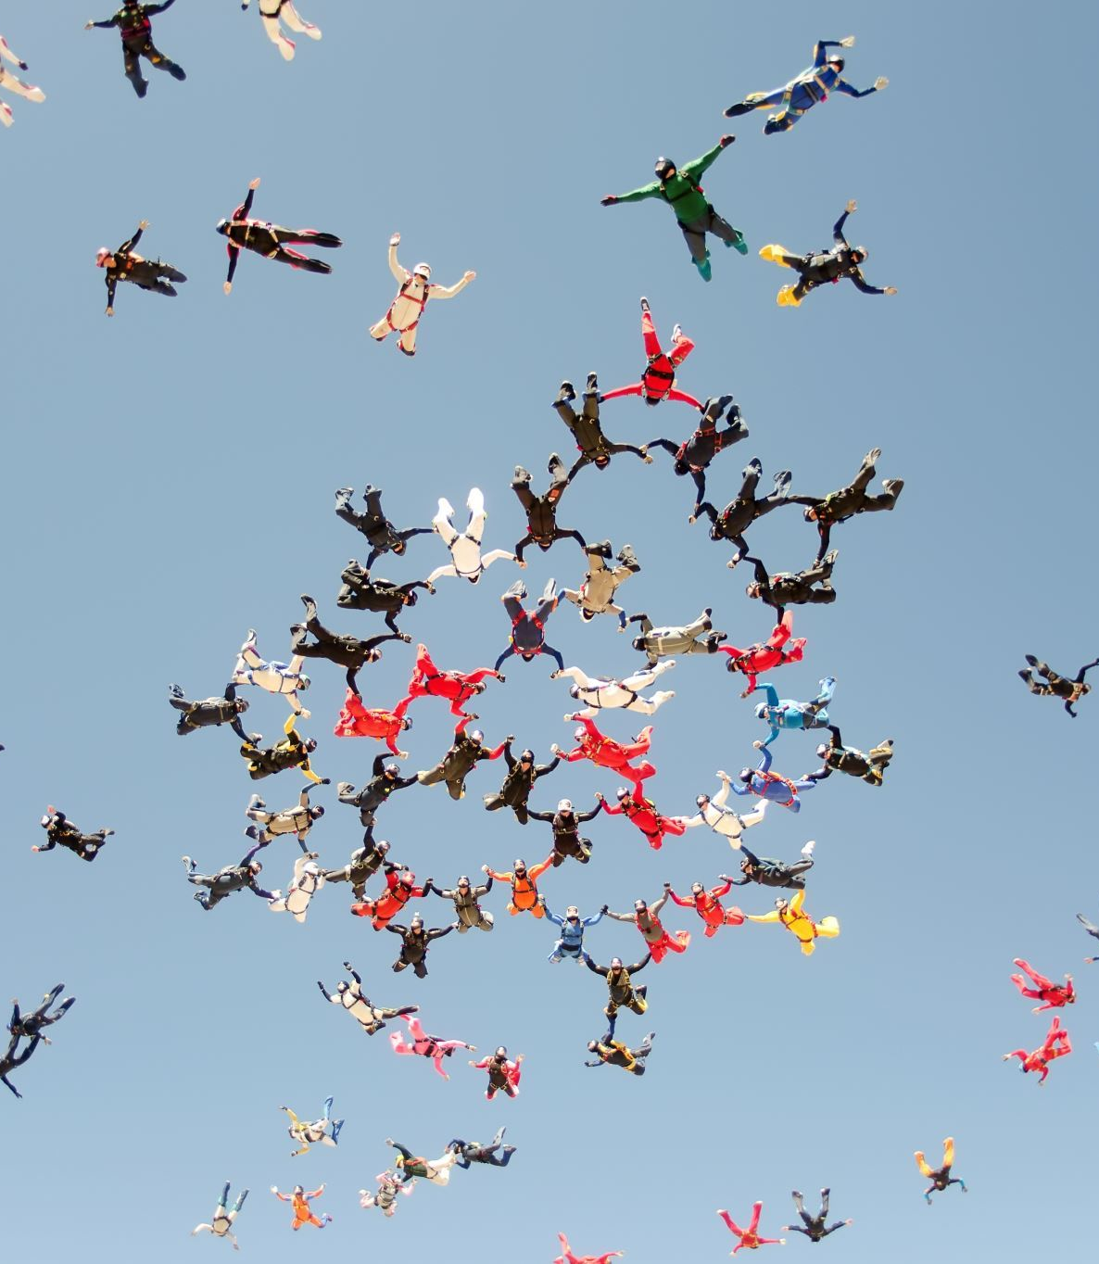
**Chapter 1: A New Chapter Begins**
The school placed a strong emphasis on cleanliness and environmental stewardship, and each student was assigned specific chores
The rhythm of school life at Muthale Girls struck a balance between academic pursuits and co-curricular activities
It was during these early years that I discovered my passion for athletics, particularly track and field events
Muthale Girls recognized the importance of nurturing athletic talent and provided the necessary infrastructure and support for students to excel in various sports

Slide 29

**Dedan Kimathi University of Technology: Nurturing Dreams Beyond the Classroom**
My journey through higher education led me to Dedan Kimathi University of Technology, a chapter in my life marked by a harmonious blend of academic pursuits, artistic passions, and a continuous pursuit of personal growth
Here, at Dedan Kimathi University, I've harnessed my passion for modeling, delved into the world of filmmaking, and furthered my academic endeavors by mastering marketable software
This transformative phase of my life is a tale of multifaceted growth and exploration, divided into several key subtopics, each representing a significant facet of my journey
Dedan Kimathi University was a fertile ground for the exploration of my passion for modeling

Slide 30
**Dedan Kimathi University of Technology: Nurturing Dreams Beyond the Classroom**
My journey into the world of modeling reached a pinnacle when I decided to compete in the prestigious Miss Dedan Kimathi Pageantry
This section of my narrative explores the preparation, challenges, and ultimately the triumph of participating in this life-changing competition
The Miss Dedan Kimathi Pageantry was not just a beauty contest; it was a platform that transcended physical appearance
This subsection provides insight into the transformation I underwent as I prepared for this life-altering event
The night of the Miss Dedan Kimathi Pageantry was a culmination of months of hard work and dedication
This section delves into the emotions, challenges, and triumphs of that transformative night

Slide 31

**My Attachment at Contrafrique Engineering & Building Services Ltd: A Journey of Skill Advancement and Lifelong Connections**
Embarking on my attachment at Contrafrique Engineering & Building Services Ltd was a significant milestone in my journey as a civil engineering student
This period was not only an opportunity to apply the knowledge I had acquired in the classroom but also a transformative experience that would shape my career and personal growth
This chapter sets the stage for my attachment experience, filled with a blend of eagerness and curiosity
At Contrafrique Engineering & Building Services Ltd, I was given the opportunity to work on real-life projects, ranging from structural design to site inspections

Slide 32
**My Attachment at Contrafrique Engineering & Building Services Ltd: A Journey of Skill Advancement and Lifelong Connections**
This chapter delves into the practical applications of my academic knowledge, the challenges I encountered, and the valuable lessons I learned from hands-on experience
This chapter explores the impact of mentorship on my professional growth and the enduring relationship I developed with Eng
This chapter chronicles my journey of acquiring proficiency in software like AutoCAD, STAAD Pro, and ETABS

Slide 33
**A Life Committed to Community Service: The Sheila Chronicles**
In a world where selflessness often takes a backseat to personal pursuits, my journey into the realm of community service began long before I could fully comprehend the impact of my actions
From my earliest years, a passion for making a difference in the lives of others has been the guiding force of my existence
This is a story of selflessness, empathy, and an unshakable belief in the power of service to transform not only the lives of others but also my own
My journey into community service had humble beginnings
The early stages of my commitment to community service were marked by seemingly insignificant acts of kindness

Slide 34
**A Life Committed to Community Service: The Sheila Chronicles**
This chapter explores the pivotal role of education in shaping my perspective on the world and the systemic issues that perpetuate inequality and social injustice
I have a unique gift for rallying people to join me in service projects, demonstrating that the power of collective action can be a potent force for good
This section delves into the ways in which I motivate and mobilize others to join in the cause

